Slide 1
A new datatype in LabVIEW
Sets and Maps
Peter Horn – CLA/CTA
Senior Applications Engineer - NI

Slide 2

#OurGiantsAreFemale
Margaret Hamilton
Wrote the code for the 1969 Apollo 11 mission to the moon
Included priority alarm displays to interrupt the astronauts normal displays in an emergency during landing – giving them a go/no-go decision
Developed early software for predicting weather on LGP-30 and PDP-1 computers
Contributed to publications on chaos theory

Slide 3
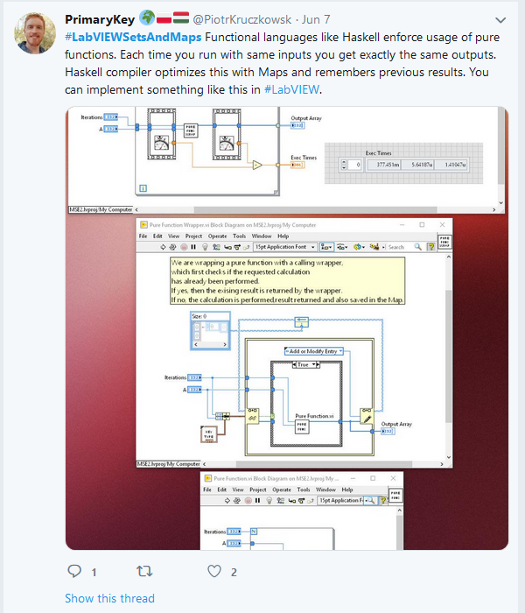
Thanks to PrimaryKey (Piotr Kruczkowsk)

Slide 4
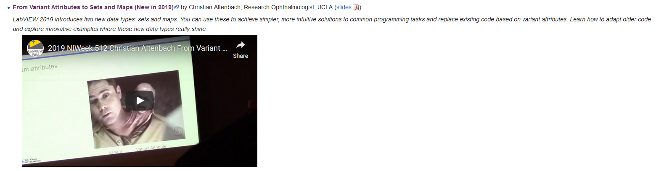
Thanks also Christian Altenbach
https://www.youtube.com/watch?v=5L9tqv3a5TU&feature=youtu.be
https://labviewwiki.org/wiki/NIWeek_2019

Slide 5
Agenda
What are LabVIEW Sets and Maps?
What are they good for, and why are they brilliant?
Example use cases
Sets
Maps
Some other cool stuff built in to the environment
Performance comparison

Slide 6
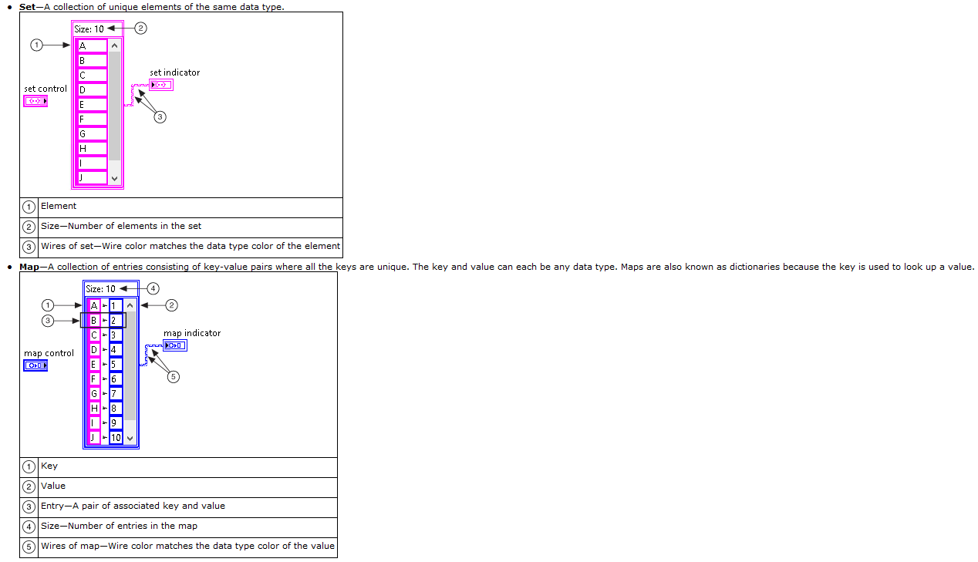
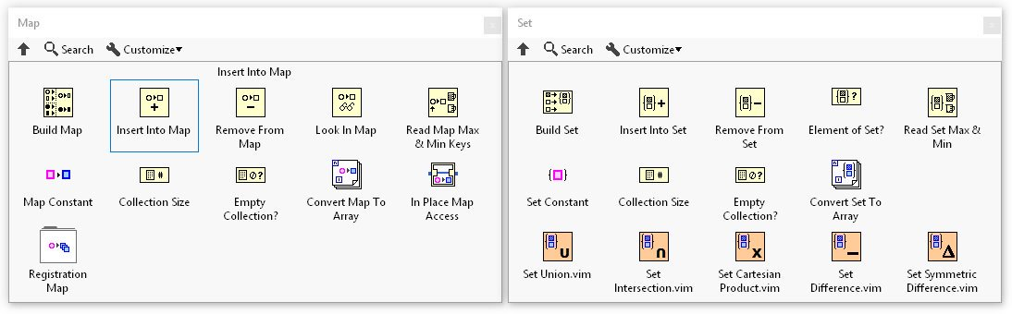
What are LabVIEW Sets and Maps?
Notes:
Its worth noting that some of the vim’s inside the Sets palette also work on Maps.
You may see other names such as Dictionaries, Associative Arrays and Hash Tables. These are all very similar to Maps and can now be programmed in LabVIEW.
In the past LabVIEW users have achieved this functionality through Variant Attributes.

Slide 7
What are they good for, and why are they brilliant?
Having the information is useless unless we can find it efficiently
Sets and Maps are optimised for storing information and efficient searching
Does this entry exist? (sets: element, maps: key)
If it exists, what is the value (maps: value)
Sets and Maps are optimised for dynamic changes to the data
Add entry (maps, sets)
Remove entry (maps, sets)
Replace value (IPE (3 modes), maps)

Slide 8
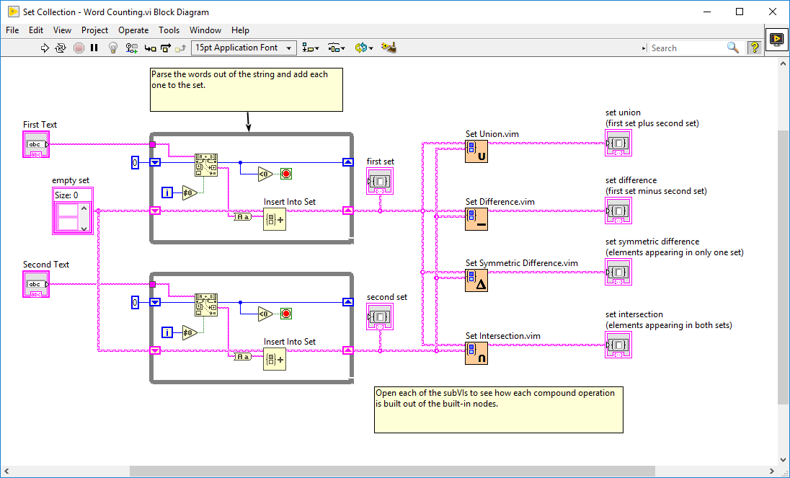
Sets
Collection of unique elements sorted into order
As they are sorted, it is very quick to check whether a given element is present or to iterate through the collection

Slide 9
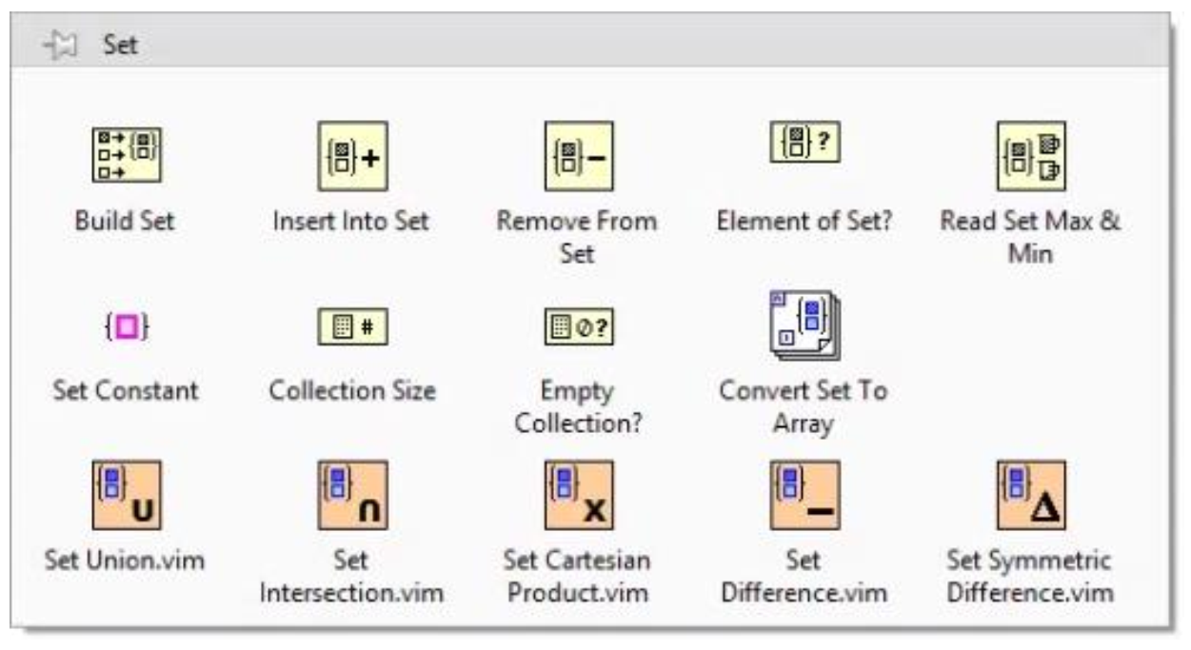
Sets

Slide 10
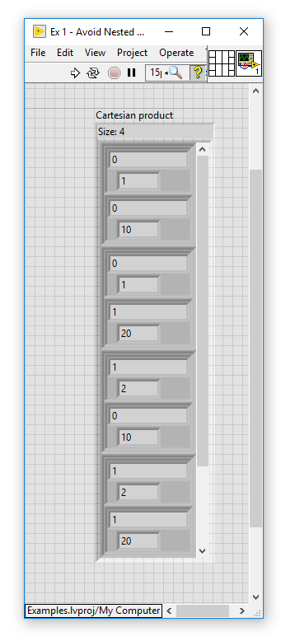
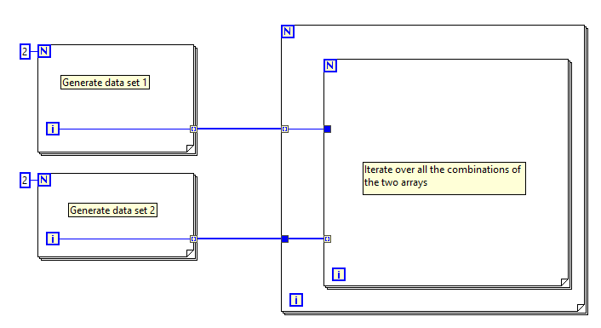
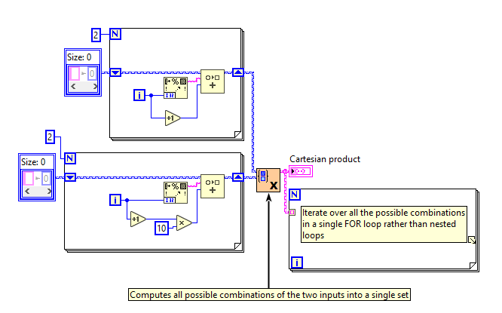
Avoid nested loops

Slide 11
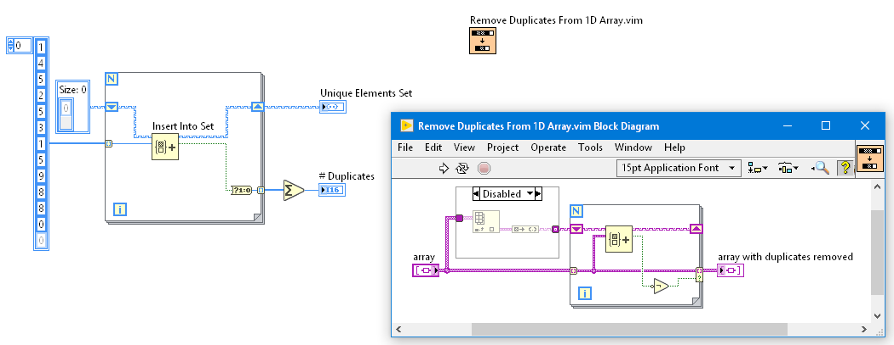
Finding unique elements in an array

Slide 12
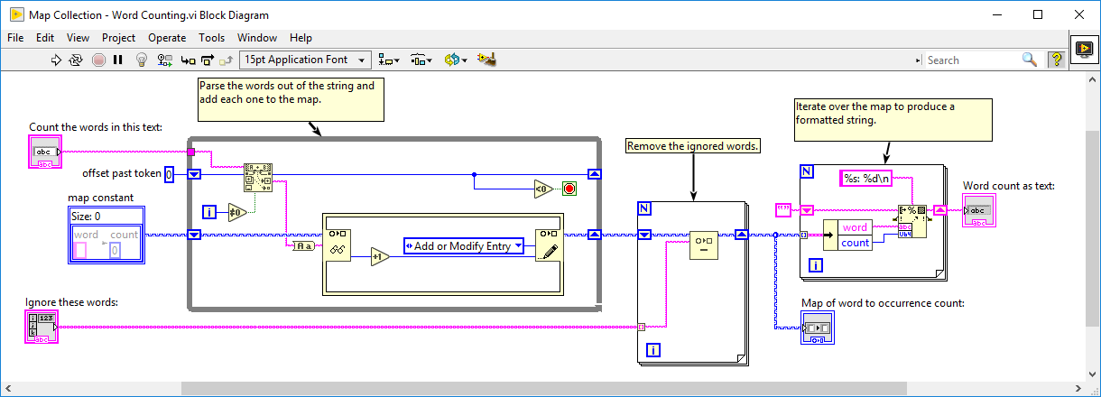
Maps
Collection of unique keys with values. Both keys and values can have custom data types

Slide 13
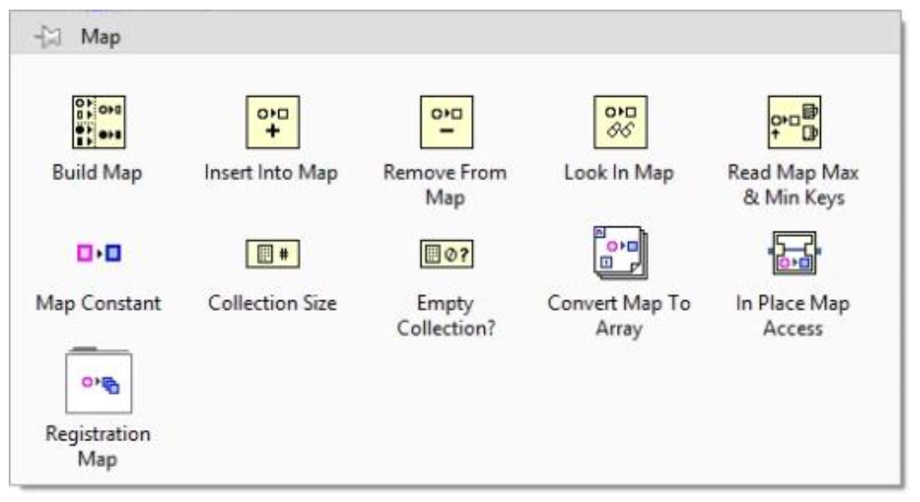
Maps

Slide 14
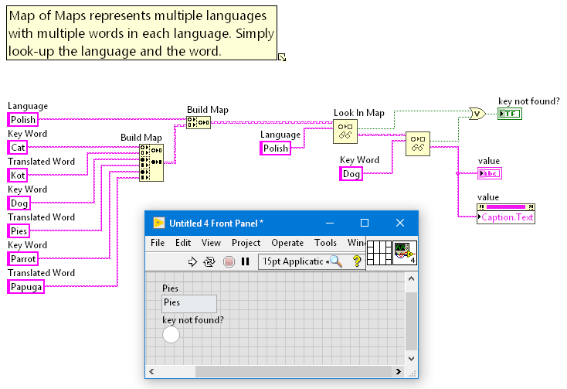
Build a translation utility

Slide 15
Service management
Service 2
Service 3
Service 1
Central Service Module
Service 4
Service 6
Service 5
Notes:
I’ve run into situations in the past where I need to keep track of which Service Modules are currently active, and what responsibilities they have. I’ve tried to build things like a variant attribute table, or a JSON config string to keep records of the data, maps can help here too. There is an example in the example finder named Registration Map Usage which shows how to do it.

Slide 16
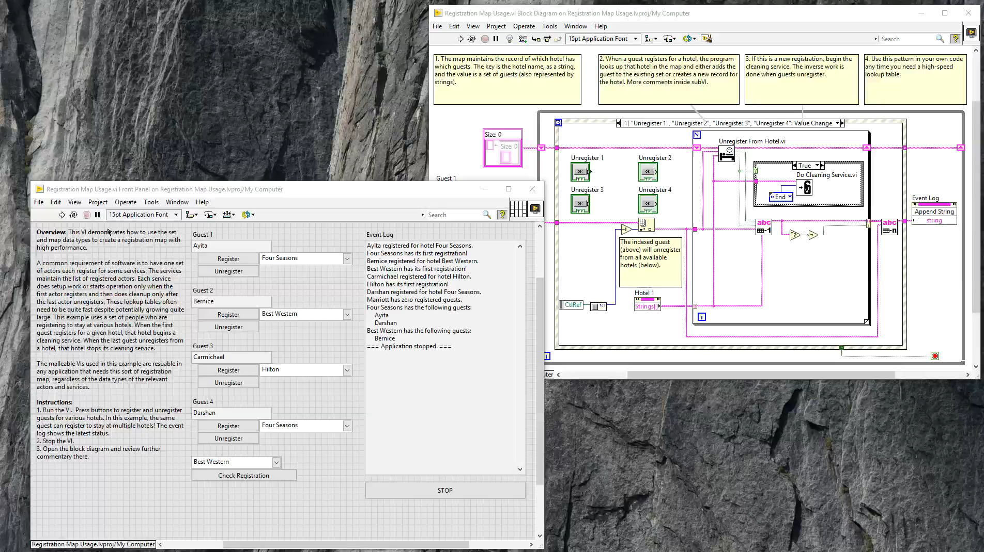
Service/Actor Management

Slide 17
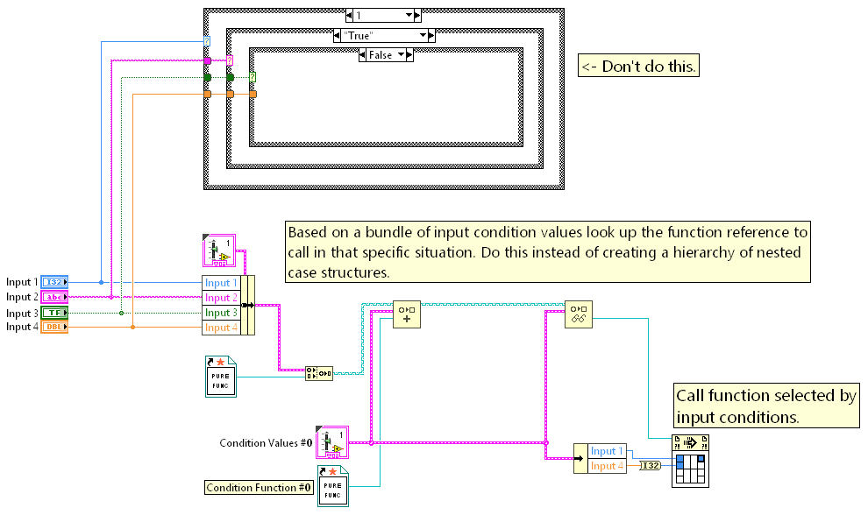
Decision trees

Slide 18
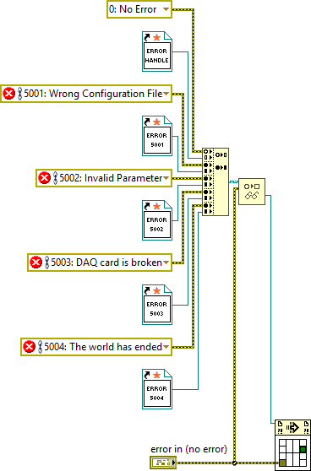
Decision trees

Slide 19
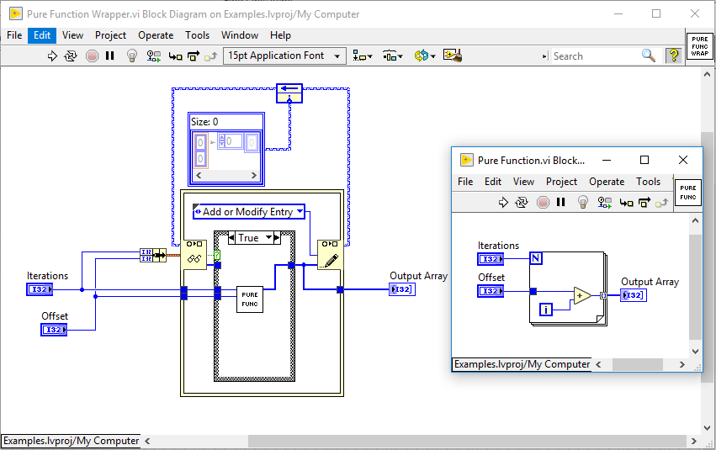
Remembering previous results
Notes:
If Pure Function is complex and takes a long time to execute, it may be worth remembering the result so that if it is called again with the same parameters, we can just pass out the result without executing. This can be stored in a map.

Slide 20
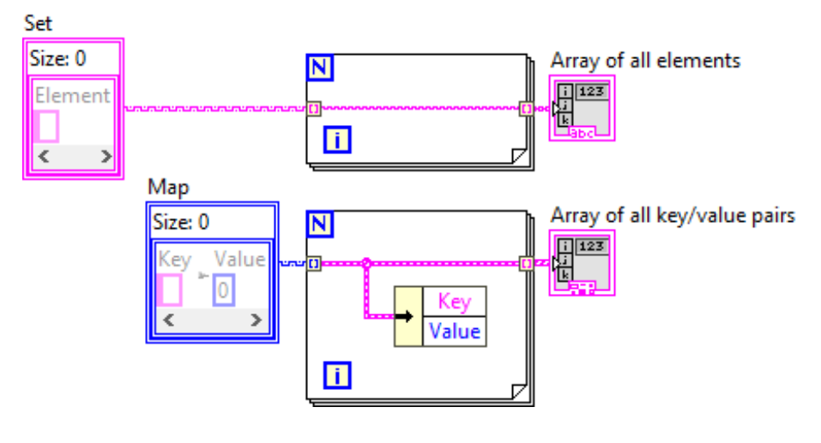
Indexing a FOR loop
Set: autoindexing gives all elements sorted
Map: autoindexing gives cluster of key/value pairs sorted by key
Good idea to name the key/value constants in the data type for self documenting code

Slide 21
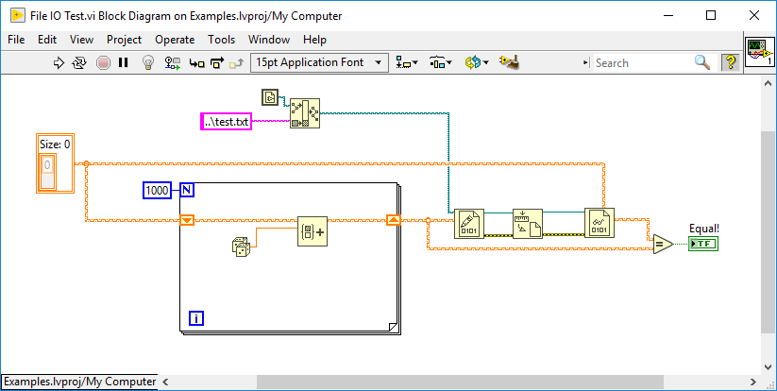
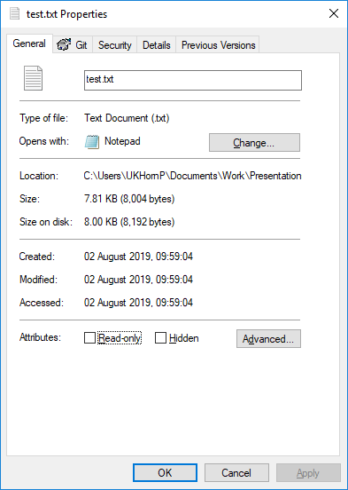
File IO – Zero overhead

Slide 22
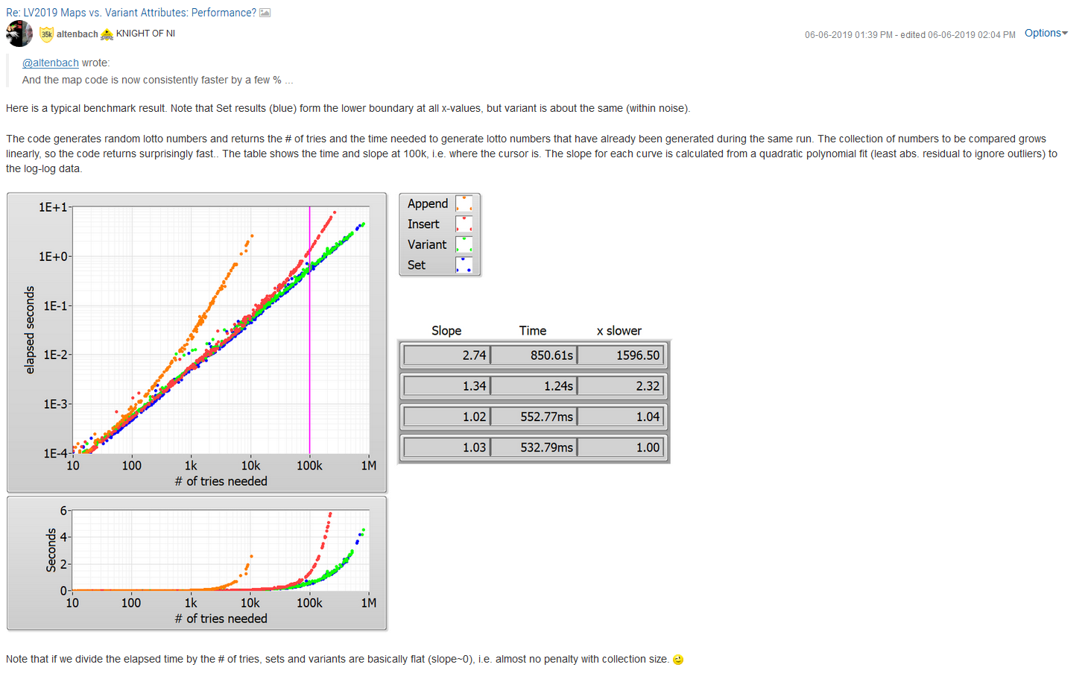
Performance

Slide 23
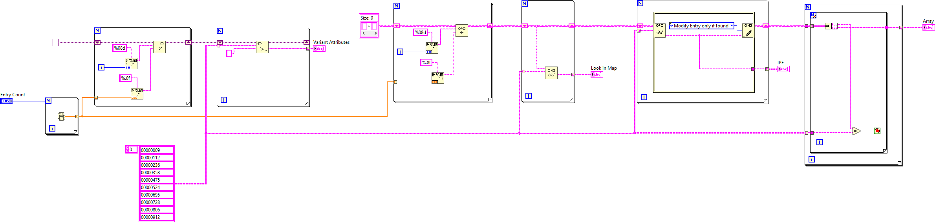
Performance – Maps vs variant attributes
Building the table
Which will be fastest?
Variant attributes or maps
Finding items in the table
Which will be fastest?
Variant attributes, looking in maps, using the in place element structure or converting to an array

Slide 24
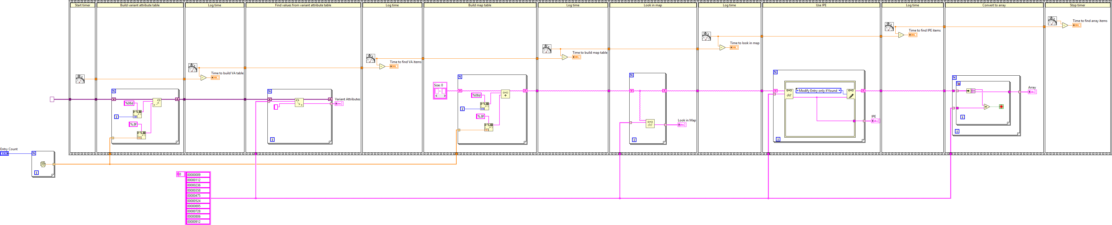
Performance – Maps vs variant attributes

Slide 25
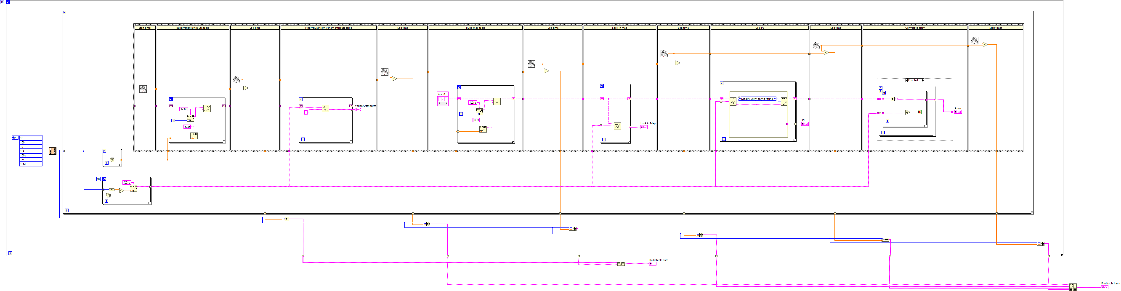
Performance – Maps vs variant attributes

Slide 26
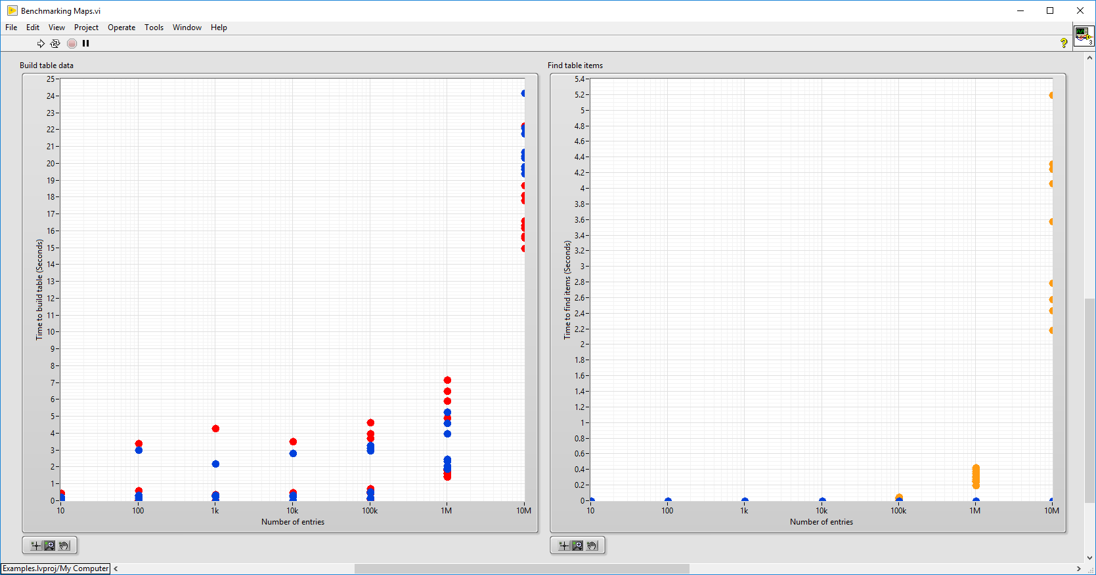
Performance – Maps vs Variant Attributes
Variant attributes
Variant attributes
Maps
Look in maps
In Place Element
Convert to array
Notes:
Blue is Variant Attributes on both plots
Red is Maps on the table build plot, look in map on the find table items map
Green is In Place Element find method
Orange is Convert to Array find method.

Slide 27
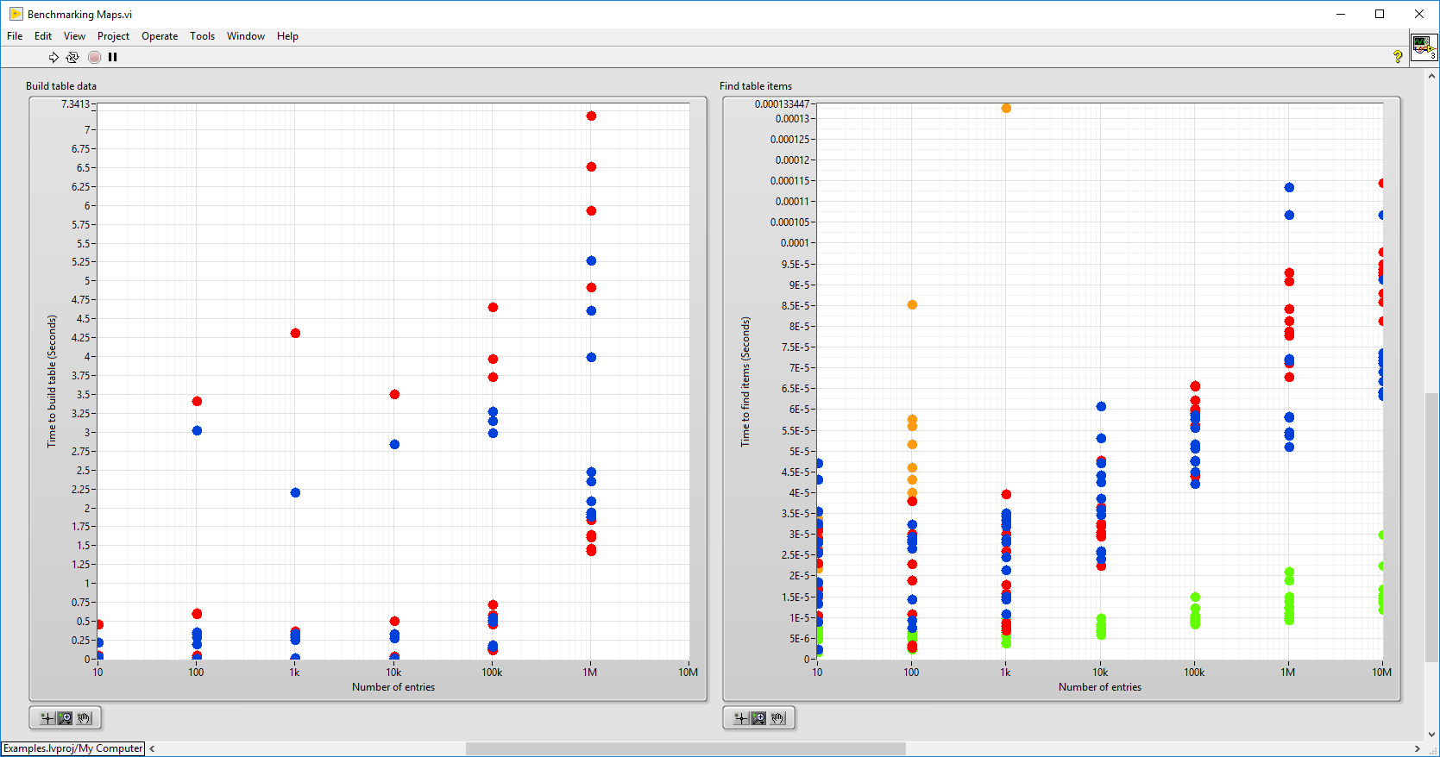
Performance – Maps vs Variant Attributes
Variant attributes
Variant attributes
Maps
Look in maps
In Place Element
Convert to array
Notes:
Blue is Variant Attributes on both plots
Red is Maps on the table build plot, look in map on the find table items map
Green is In Place Element find method
Orange is Convert to Array find method.

Slide 28
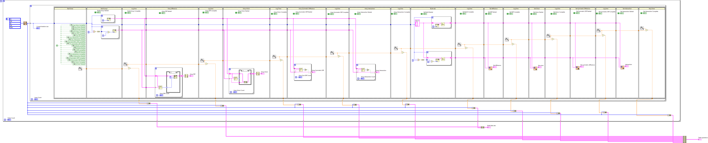
Performance – Sets vs arrays
Performing the same 5 operations on an array and then set
Build data set
Difference (elements in first set but not in second)
Union (all elements that belong to either set)
Symmetric Difference (elements in only one set)
Intersection (elements in both sets)
Which is faster? And by how much???

Slide 29
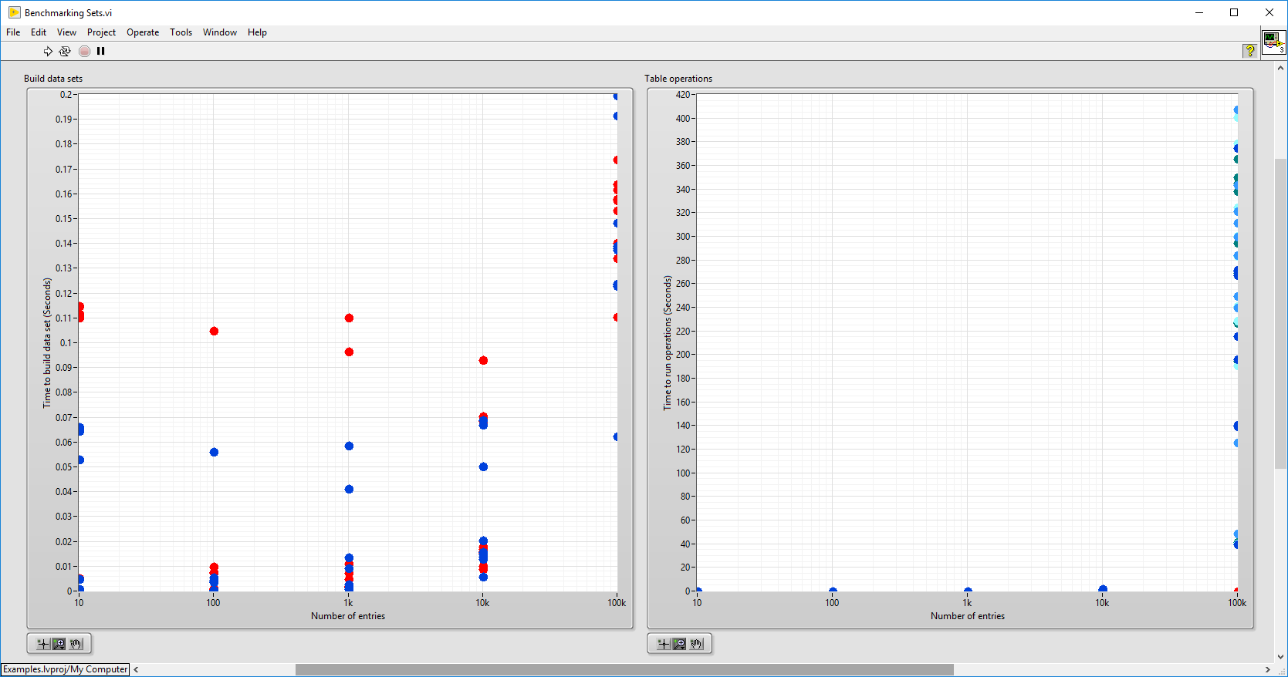
Arrays
Arrays
Sets
Sets
Notes:
Blue/turquoise/green is arrays
Red/orange/yellow is sets

Slide 30
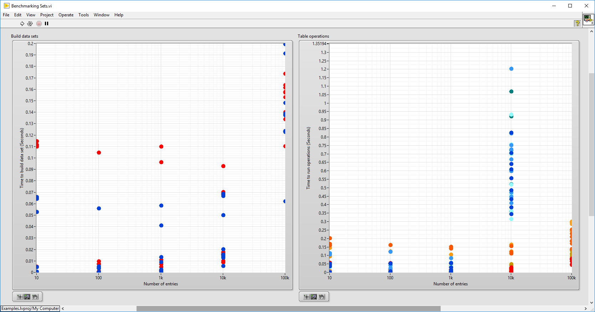
Arrays
Arrays
Sets
Sets
With 100k elements
133 – 8,200 x faster

Slide 31
Summary
Sets and Maps are another tool in LabVIEW
Great when you need a flexible data table which enables quick/efficient data access
Enables new ways of building algorithms
Should aid reducing complexity in some cases
Should be higher performance in some cases, especially very large data sets
Arrays and variant attributes still remain as good solutions to some use cases
Bottom line – Sets and maps are potentially a very powerful tool to understand and use in LabVIEW
Enables some very abstract but powerful programming methods – up to you if that is beneficial or not

Slide 32


https://github.com/PeteHorn/LV-Sets-Maps-UKTAG

